Slide 1
Mustansir Hussain Salik
So Far At IBA

Slide 2
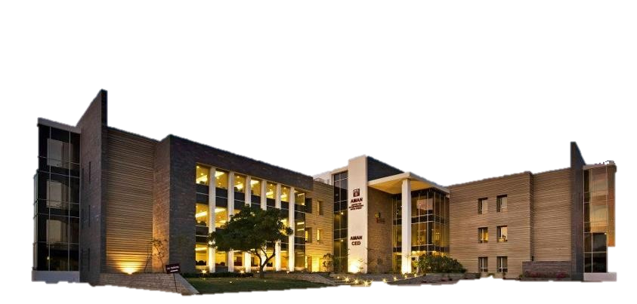
To be a part of IBA was a dream coming true…

Slide 3

First impression of IBA was very touching as the management team of the orientation session greeted me in a very hospitable manner…

Slide 4

Diversity in IBA in terms of the background of students is that characteristic of IBA which I like the most…

Slide 5
Learning… Apart from academic learning I utilized my time in seeking something new as I completed two courses from Coursera i.e., Python and Excel and another Freelancing course from DigiSkill.

Slide 6
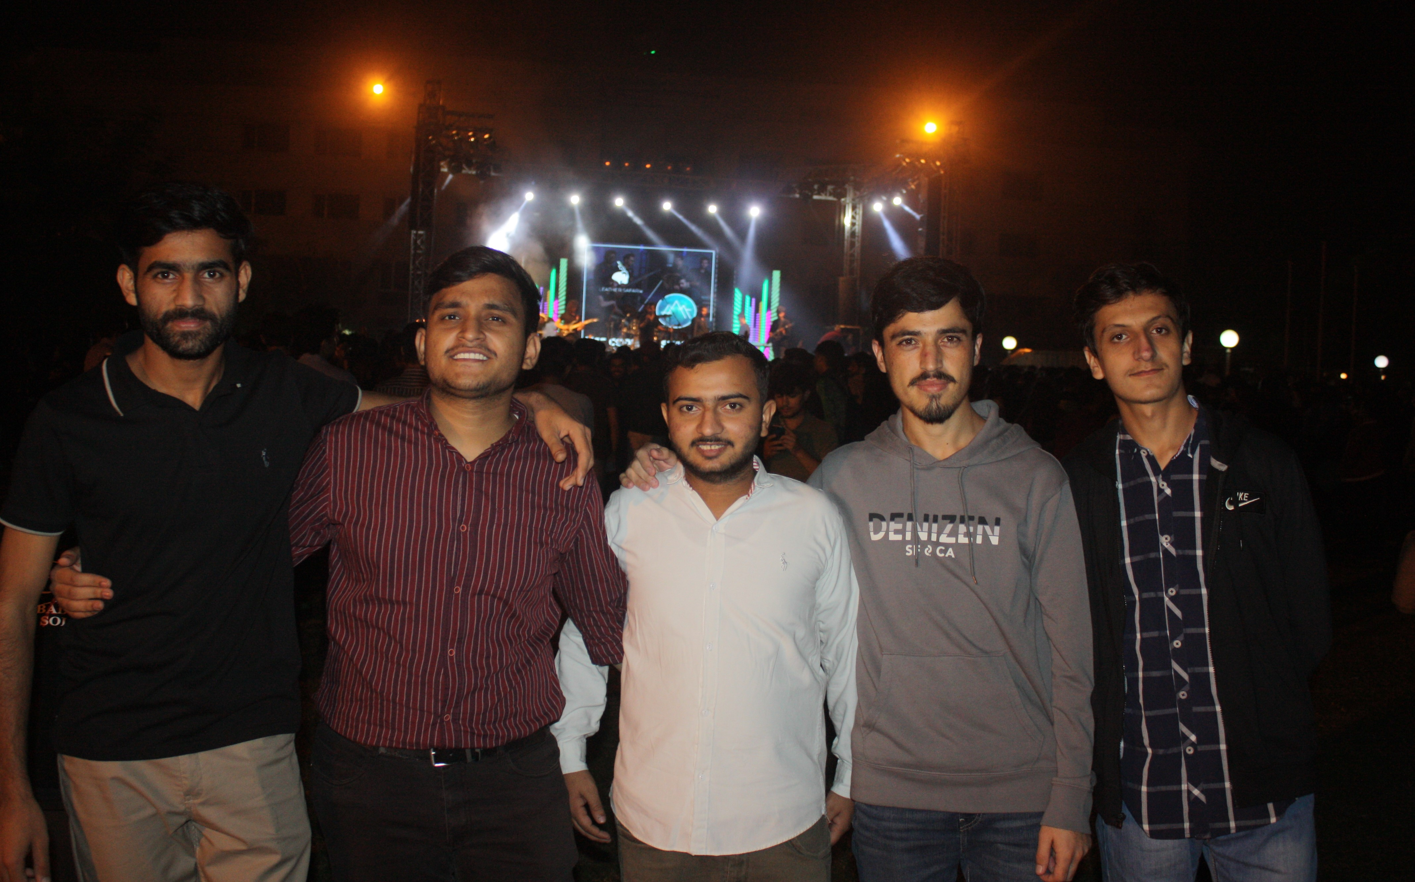
Making new friends… Although I am not very good at making friends, but I managed to form friendship with more people than I had guessed.

Slide 7

Events at IBA are amazing opportunities to participate and learn new skills and knowledge.

Slide 8
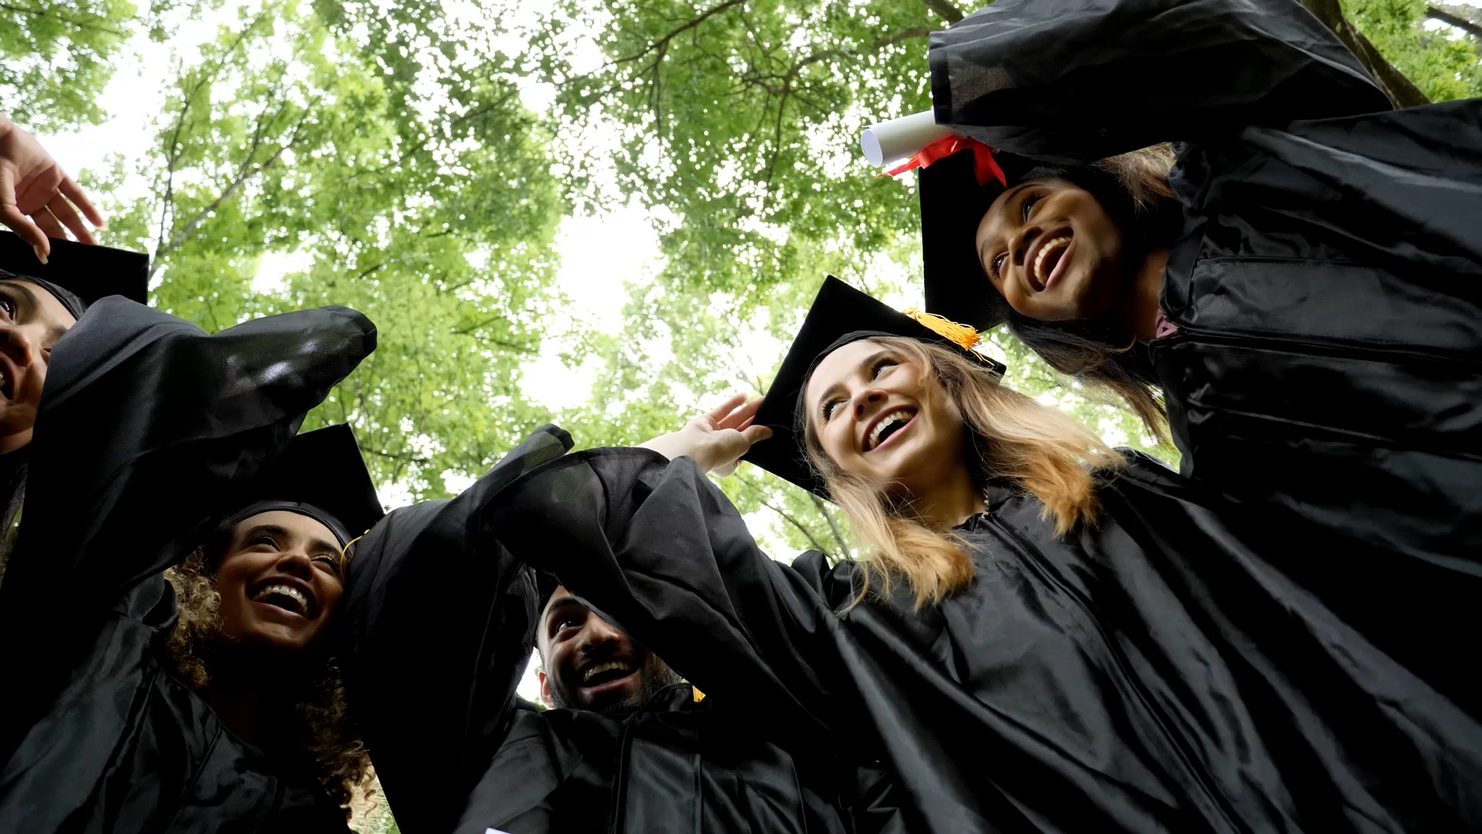
This was my beginning at IBA, a lot more to come, a lot more to learn, a lot more to see till graduation…

Slide 9


